Slide 1
Kubernetes Workshop: Develop and Deploy a Microservices Application on Kubernetes
Dell Technologies Educations Services

Slide 2
Workshop Agenda
DAY 2
Deploying containerized workloads on Kubernetes with pipeline
Persisting data in Kubernetes using PV & PVC
Logging and Monitoring

Slide 3
Build CI/CD Pipeline for your Containers
Notes:
3
09-07-2020

Slide 4
Release Process Stages
Source
Build
Test
Production
Check in source code
Get Peer review done
Compile code
Unit Tests
Style Checkers
Build and push container images
Integration Tests with other systems
Load Testing
UI Tests
Security Testing
Deployment to production
Environments
Monitor code in production
to quickly detect errors
Continuous Integration
Continuous Deployment

Slide 5

Release Process Stages
Source
Build
Test
Production
Check in source code
Get Peer review done
Compile code
Unit Tests
Style Checkers
Build and push container images
Integration Tests with other systems
Load Testing
UI Tests
Security Testing
Deployment to production Environments
Monitor code in production
to quickly detect errors
Continuous Integration
Continuous Delivery

Slide 6
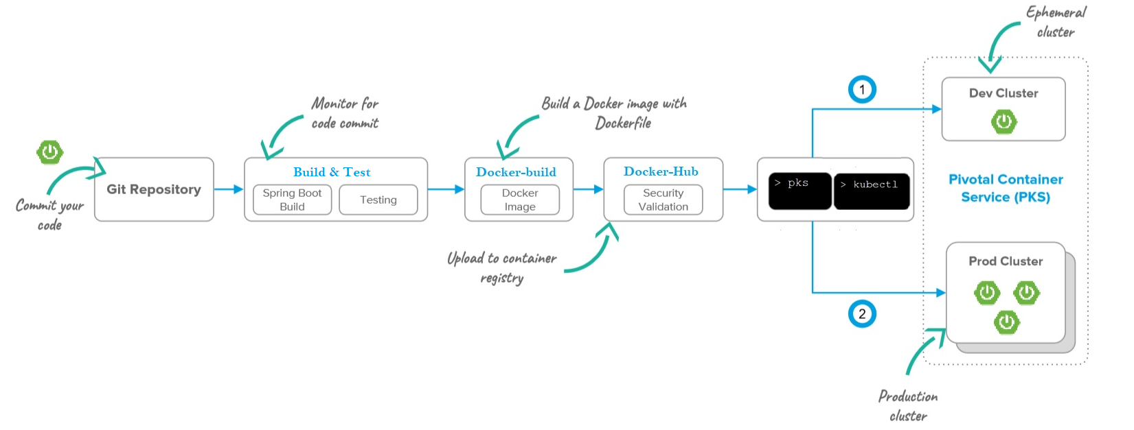

Continuous Deployment to PKS
Github Actions

Slide 7
Lab 5: Buid Pipeline with Github Actions

Slide 8
Understanding Persistent Storage in Kubernetes
Notes:
Bob - v,sc
Jeff - pv,pvc

Slide 9
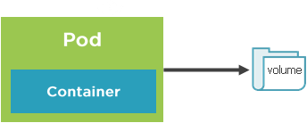
Storage Core Concepts
Pods live and die so their file system is short lived(ephemeral)
Volumes can be used to store state/data and use it in pod
A pod can have multiple volumes attached to it.
Containers rely on a mount path to access a volume
Kubernetes supports :
Volumes
PersistentVolumes
PersistentVolumesClaims
StorageClasses

Slide 10
Volumes and Volume mounts
A volume references a storage location
Must have a unique name
Attached to pod and may or may not be tied to the Pod’s lifetime
A volume mount references a volume by name and defines a mountPath

Slide 11
Volume type examples
emptyDir – Empty directory for storing “transient” data (shares a Pod’s lifetime) useful for sharing files between containers running in a Pod
hostPath – Pod mounts to the node’s file system
nfs – A Network file system share mounted into the Pod
configMap/Secret – Special types of volumes that provide a Pod with access to Kubernetes resources
persistentVolumeClaim - Special types of volumes that provide a Pod with access to Kubernetes resources
Cloud – cluster wide storage

Slide 12
Volume Types
awsElasticBlockStore
azureDisk
azureFile
cephfs
configMap
csi
downwardAPI
emptyDir
fc (fibre channel)
flocker
gcePersistentDisk
gitRepo
glusterfs
hostPath
iscsi
local
nfs
persistentVolumeClaim
projected
portworxVolume
quobyte
rbd
scaleIO
secret
storageos
vsphereVolume

Slide 13
Defining an emptyDir Volume
apiVersion: v1
kind: Pod
spec:
volumes:
-name: html
emptyDir: {}
containers:
-name: nginx
image: nginx:alpine
volumeMounts:
-name: html
mountPath: /usr/share/nginx/html
readOnly: true
-name: html-updater
image: alpine
command: ["/bin/sh", "-c"]
args:
-while true; do date >> /html/index.html; sleep 10; done
volumeMounts:
-name: html
mountPath: /html
Define initial Volume named “html” that is an empty directory(lifetime of the Pod
Reference “html” Volume and define a mountPath
Update file in Volume mount /html path with latest date every 10 seconds
Reference “html” Volume (defined above) and define a mountPath

Slide 14
Persistent volumes
A Persistent volume is cluster-wide storage resource that relies on network-attached storage(NAS)
Normally provisioned by cluster administrator
Available to a pod even if it gets rescheduled to a different node
Rely on a storage provider such as NFS, cloud storage, or other options
Associated with a Pod by using a PersistentVolumeClaim(PVC)

Slide 15
PersistentVolumeClaim
A PersistentVolumeClaim (PVC) is a request for storage unit.
Satisfies a set of requirements instead of mapping to a storage resource directly.
Ensures that an application’s ‘claim’ for storage is portable across numerous backends or providers.

Slide 16
PersistentVolume Workflow
Define a persistence volume(PV) and send to the Kubernetes API
Create a PersistentVolumeclaim(PVC)
Kubernetes binds the PVC to PV
Pod volume references the PVC
Create network storage resource(NFS ,Cloud etc.

Slide 17
Storage Class Core Concepts
A storage class is a type storage template that can be used to dynamically provision storage
Used to define different classes of storage
Act as a type of storage template
Supports dynamic provisioning of PersistentVolumes
Administrators need not create PVs in advance

Slide 18
Storage Class Workflow
Create a PersistentVolumeclaim(PVC) that references a Storage Class
Pod volume references the PVC
Bind to PVC
Kubernetes uses StorageClass provisioner to provision a PersistenceVolume
Create storage class

Slide 19
Lab 6 & 7: Data Persistence in Kubernetes

Slide 20
Kubernetes Logging and Monitoring
Notes:
20
09-07-2020

Slide 21
Different types of Logs presented by Kubernetes
Nodes
Pods
Containers
Control Plane
Notes:
21
09-07-2020

Slide 22
Logs presented by Nodes
kubectl describe node
System components logs (journalctl,syslog etc

Slide 23
kubectl log examples
# Find all pods with a given label, select the first one and show its logs
$ kubectl logs $(kubectl get pod -l app=run-controller -o jsonpath="{.items[0].metadata.name}") run-controller
# Show logs of all the pods with a given label
$ kubectl logs -l app=run-controller
# Return snapshot logs from first container of a job named hello
$ kubectllogs job/hello
# Return snapshot logs from container nginx-1 of a deployment named nginx
$ kubectllogs deployment/nginx-c nginx-1

Slide 24
Logs presented by Control Plane
Pods
Containers
Control Plane
kubectl get events
System components logs (journalctl,syslog etc
Service provider logs
Notes:
24
09-07-2020

Slide 25
Filtering kubectl get events results
$ kubectl get events --field-selector type=Warning
$ kubectl get events --field-selector involvedObject.kind!=Pod
$ kubectl get events --field-selector involvedObject.kind=Node,involvedObject.name=minikube
$ kubectl get events --field-selector type!=Normal

Slide 26
kubectl top
Pods
kubectl top pod
kubectl top node
Notes:
26
09-07-2020

Slide 27
Examples of kubectl top
# Show the resource utilization of all the pods matching a label
$ kubectl top pod –l app=run-controller
# Find all nodes, select the first one and show its utilization
$ kubectl top node $(kubectl get nodes -o jsonpath="{.items[0].metadata.name}")

Slide 28
kubectl exec
Allows execution of arbitrary commands inside running containers
Can be used to call regular UNIX commands available inside the container(top,ps,tail,…
Allows interactive operations (exec –ti)

Slide 29
Examples of kubectl exec
# Find all pods with a given label, select the first one and run top in its default container
$ kubectl exec -ti$(kubectl get pod -l app=workout-gateway –o jsonpath="{.items[0].metadata.name}") top
# Find all pods with a given label, select the first one and list the files in /app
$ kubectl exec $(kubectl get pod -l app=workout-gateway -o jsonpath="{.items[0].metadata.name}") --ls -l /app

Slide 30
Lab 8 : Logging & Monitoring

